Slide 1
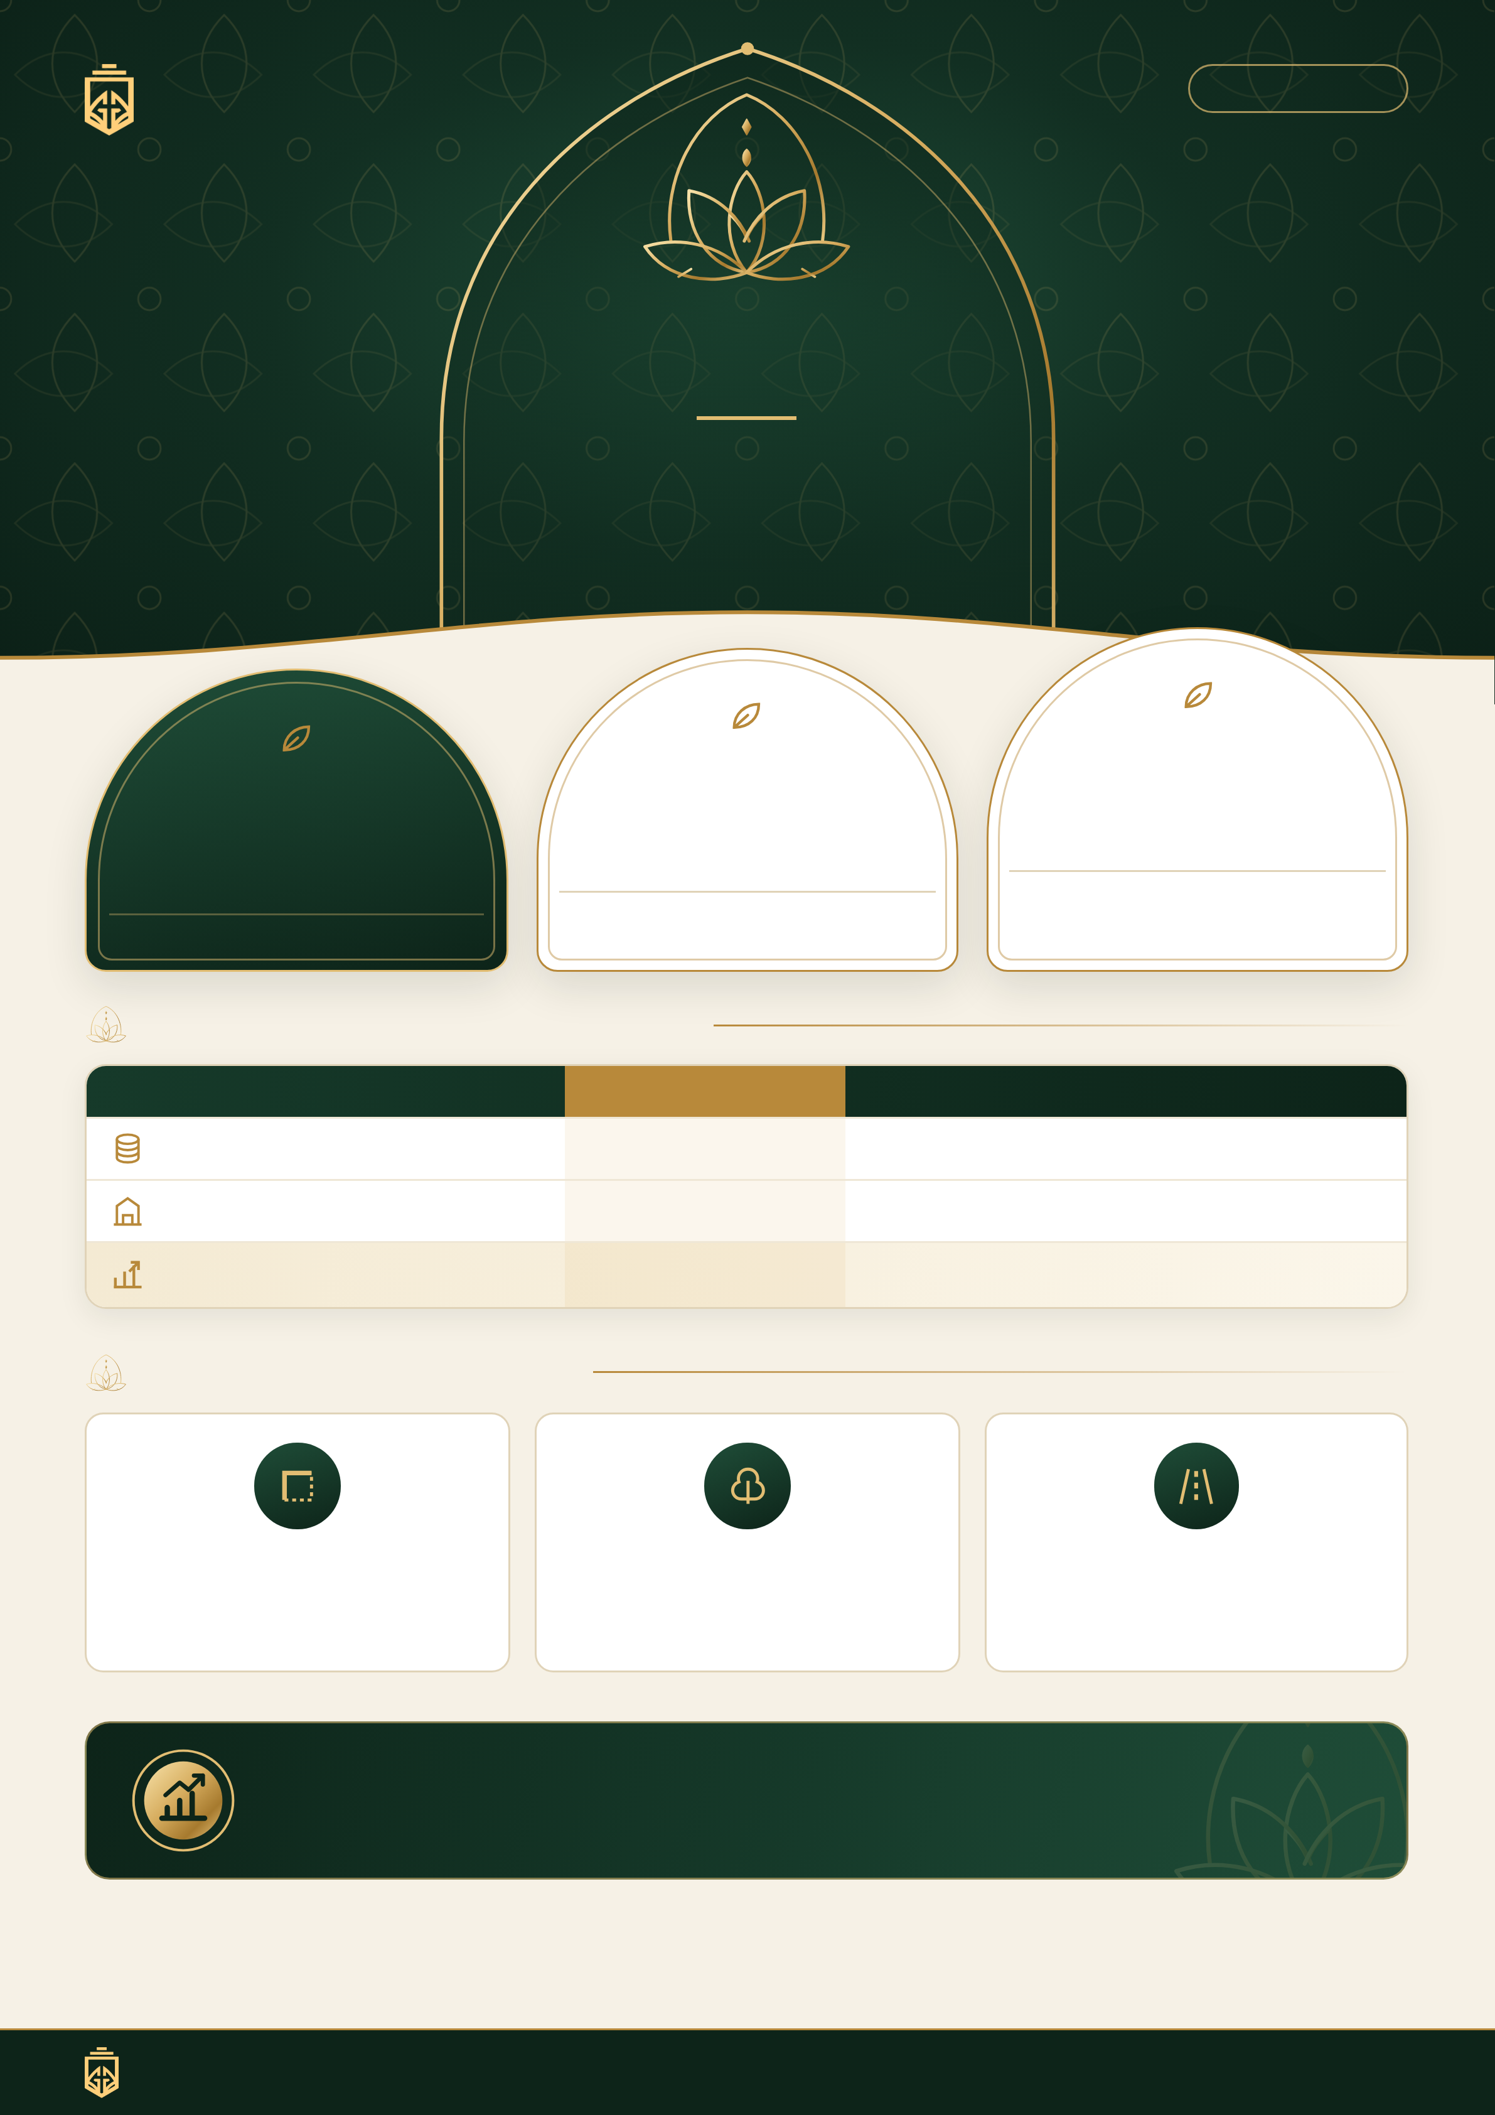
GRG
DHOLERA
NILAYA
Where the spirit of Nilachala
meets the peace of home.
PREMIUM PLOT INVESTMENT OPPORTUNITY
PRE-LAUNCH
LAUNCH
SOFT LAUNCH
₹8,500
₹9,500
₹7,500
/ Sq. Yd.
/ Sq. Yd.
/ Sq. Yd.
Effective ₹10,500 incl. development
Effective ₹8,500 incl. development
Effective ₹9,500 incl. development
Transparent Cost Structure
PARTICULAR
SOFT LAUNCH
PRE-LAUNCH
LAUNCH
Plot Rate / Sq. Yd.
₹7,500
₹8,500
₹9,500
Development / Sq. Yd.
₹1,000
₹1,000
₹1,000
Effective Rate incl. Development
₹8,500
₹9,500
₹10,500
Premium Location PLC
Corner Plot
Garden Facing / Garden Touch
40 Ft Road Facing
+10%
+10%
+10%
EARLY-ENTRY ADVANTAGE
Secure your preferred plot at the soft-launch rate before the project moves to pre-launch and launch pricing.
Note: Development charges are ₹1,000 per sq. yd. PLC is applicable as per plot attributes. Where more than one qualifying PLC applies, the final payable amount should be confirmed as per the project's allotment/pricing policy. Taxes, registration, stamp duty and other statutory charges, if applicable, are additional.
GRG
Nilaya · Dholera
GARGREALTYGROUP.COM

